Slide 1
Timetable Mobile Application
Oskar Ciebien
G00369579
Supervisor:
Mr. Martin Hynes

Slide 2
Context & Objectives
Developing a timetable Mobile Application. With additional security features.
Upload App to the Google Store and maybe Apple App Store.
Security features such as PIN, Fingerprint and hopefully Google Two-Factor Authentication.
Develop an easy-to-use application.
Good design of the application.

Slide 3







Technologies & System Architecture
React Native – App
Visual Studio Code – IDE
GitHub – Version Control
Android Studio – Android Emulator
Firebase – Database
Android – Testing Locally and Targeted Device
Apple – Targeted Device (Maybe)

Slide 4

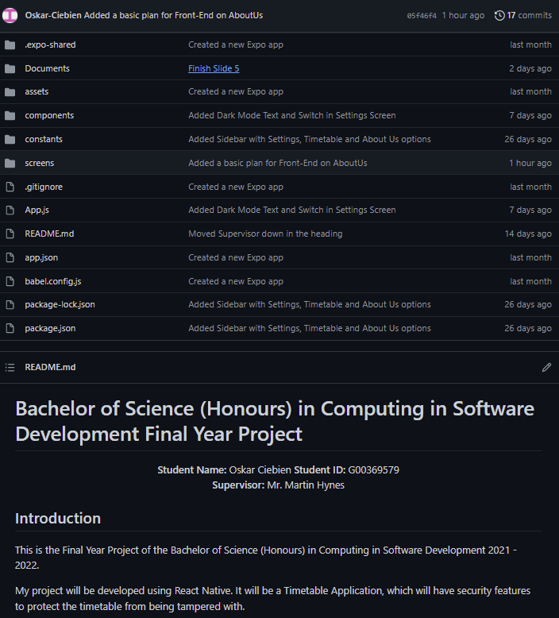
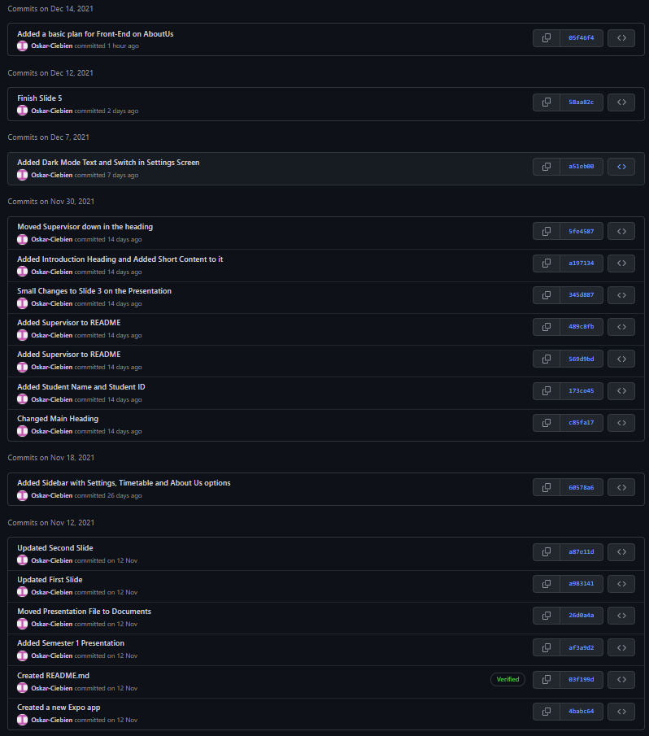
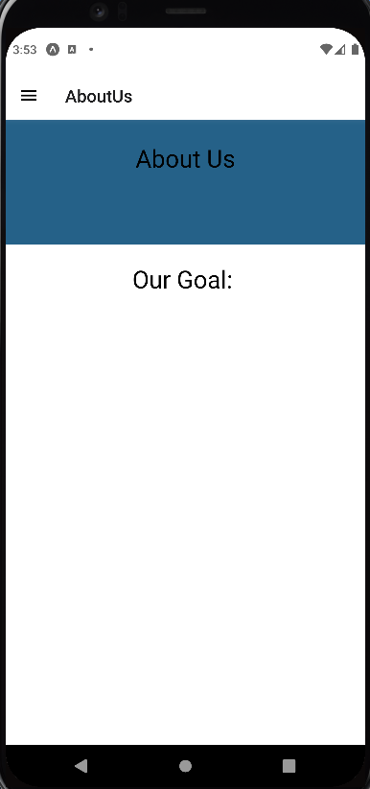
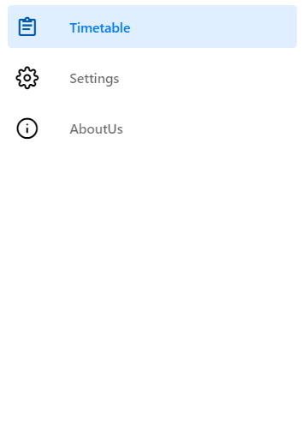
Development & Deployment

